Slide 1
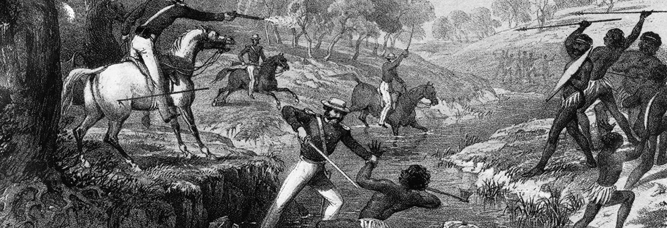

Post-Colonialism and The Secret River
LITERATURE THROUGH A CRITICAL LENS

Slide 2




LITERARY THEORY
Key Points: Authorial intent is not important.
The value of texts is the impact they have on the reader.
We use language to try to communicate our experience of our world to others.
All texts are products of their context and reflect particular ideologies and value systems.
Notes:
These ideologies often include the dominant ideologies.

Slide 3
TRADITIONAL LITERARY CRITICISM
tracking influence, establishing the canon of major writers in the literary periods, and clarifying his
key feature of traditional literary criticism was the consensus within the academy as to the both the literary canon (that is, the books all educated persons should read) and the aims and purposes of literature, Historical context and allusions within the text.

Slide 4
POST-COLONIALISM
post-colonial critics are concerned with literature produced by colonial powers and works produced by those who were/are colonized.
Post-colonial theory looks at issues of power, economics, politics, religion, and culture and how these elements work in relation to colonial hegemony (Western colonizers controlling the colonized).
Post-colonial criticism also questions the role of the Western literary canon and Western history as dominant forms of knowledge making. The terms "First World," "Second World," "Third World" and "Fourth World" nations are critiqued by post-colonial critics because they reinforce the dominant positions of Western cultures populating First World status.
This critique includes the literary canon and histories written from the perspective of First World cultures. a post-colonial critic might question the works included in "the canon" because the canon does not contain works by authors outside Western culture.

Slide 5
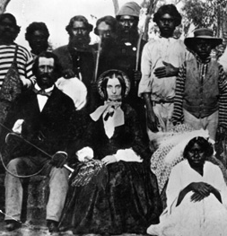
HISTORY IS WRITTEN BY THE VICTORS
Post-colonial criticism is similar to cultural studies, but it assumes a unique perspective on literature and politics that warrants a separate discussion. Specifically, post-colonial critics are concerned with literature produced by colonial powers and works produced by those who were/are colonized
Therefore, a post-colonial critic might be interested in works such as Daniel Defoe's Robinson Crusoe where colonial "...Ideology [is] manifest in Crusoe's colonialist attitude toward the land upon which he's shipwrecked and toward the black man he 'colonizes' and names friday" (Tyson 377). In addition, post-colonial theory might point out that "...Despite Heart of Darkness's (Joseph Conrad) obvious anti-colonist agenda, the novel points to the colonized population as the standard of savagery to which Europeans are contrasted" (Tyson 375).

Slide 6
Hegemony - Definition
“hegemony, Hegemony, the dominance of one group over another, often supported by legitimating norms and ideas. The term hegemony is today often used as shorthand to describe the relatively dominant position of a particular set of ideas and their associated tendency to become commonsensical and intuitive, thereby inhibiting the dissemination or even the articulation of alternative ideas. The associated term hegemon is used to identify the actor, group, class, or state that exercises hegemonic power or that is responsible for the dissemination of hegemonic ideas.”
Retrieved from: https://www.britannica.com/topic/hegemony
Discussion Question: Is our society as controlled by a matriarchal hegemon or a patriarchal hegemon? Provide reasons for your argument.

Slide 7
Cultural Hegemony
In Marxist philosophy, cultural hegemony is the domination of a culturally diverse society by the ruling class which manipulates the culture of that society —the beliefs and explanations, perceptions, values, and mores — so that the imposed, ruling-class worldview becomes the accepted cultural norm;
Questions:
Which culture dominates Indigenous culture in The Secret River?
Is the culture represented in such a way that modern audiences agree with the power dynamic?
Why/why not? How
Notes:
British Hegemony
No -
Cultural divide, treating them an inferior, their farming practices, taking care of the land to ensure food sources, stable social structure, Aboriginal people represented as strong and beautiful, represented as an extension of the land - in the way that they were meant to be there. The aboriginal people were represented as powerful hunter - they only killed the British settlers with they were retaliating/protecting themselves.

Slide 8
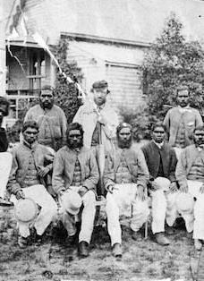
POWER, HEGEMONY, AND LITERATURE
Moreover, the authors included in the canon often reinforce colonial hegemonic ideology, such as Joseph Conrad. Western critics might consider Heart of Darkness an effective critique of colonial behaviour. But post-colonial theorists and authors might disagree with this perspective: "...As Chinua Achebe observes, the novel's condemnation of European is based on a definition of Africans as savages: beneath their veneer of civilization, the Europeans are, the novel tells us, as barbaric as the Africans. And indeed, Achebe notes, the novel portrays Africans as a pre-historic mass of frenzied, howling, incomprehensible barbarians..." (Tyson 374-375).

Slide 9
Neocolonialism
Neocolonialism is the practice of using economics, globalisation, cultural imperialism and conditional aid to influence a country instead of the previous colonial methods of direct military control (imperialism) or indirect political control (hegemony).
Neocolonialism, the control of less-developed countries by developed countries through indirect means. The term neocolonialism was first used after World War II to refer to the continuing dependence of former colonies on foreign countries, but its meaning soon broadened to apply, more generally, to places where the power of developed countries was used to produce a colonial-like exploitation—for instance, in Latin America, where direct foreign rule had ended in the early 19th century. The term is now an unambiguously negative one that is widely used to refer to a form of global power in which transnational corporations and global and multilateral institutions combine to perpetuate colonial forms of exploitation of developing countries. Neocolonialism has been broadly understood as a further development of capitalism that enables capitalist powers (both nations and corporations) to dominate subject nations through the operations of international capitalism rather than by means of direct rule.
From <https://www.britannica.com/topic/neocolonialism>
Questions:
Discuss how neocolonialsm is relevant to contemporary Australian.
2. How might neocolonialism be represented in The Secret River?

Slide 10
Postcolonial Lense
A post-colonial reading - typical questions:
How does the literary text, explicitly or allegorically, represent various aspects of colonial oppression?
What does the text reveal about the problematics of post-colonial identity, including the relationship between personal and cultural identity and such issues as double consciousness and hybridity?
What person(s) or groups does the work identify as "other" or stranger? How are such persons/groups described and treated?
What does the text reveal about the politics and/or psychology of anti-colonialist resistance?
What does the text reveal about the operations of cultural difference - the ways in which race, religion, class, gender, sexual orientation, cultural beliefs, and customs combine to form individual identity - in shaping our perceptions of ourselves, others, and the world in which we live?
How does the text respond to or comment upon the characters, themes, or assumptions of a canonized (colonialist) work?
Are there meaningful similarities among the literatures of different post-colonial populations?
How does a literary text in the western canon reinforce or undermine colonialist ideology through its representation of colonialization and/or its inappropriate silence about colonized peoples? (Tyson 378-379)

Slide 11
COLONIAL AND POST-COLONIAL ASPECTS OF AUSTRALIAN IDENTITY.
The colonisation of Australia had a devastating impact on Indigenous people, who have lived on this land for thousands of years.
Prior to British settlement, more than 500 Indigenous groups inhabited the Australian continent, approximately 750,000 people in total.[
Their cultures developed over 60,000 years, making Indigenous Australians the custodians of the world’s most ancient living culture. Each group lived in close relationship with the land and had custody over their own country.

Slide 12
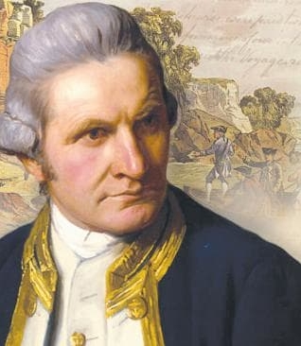
CAPTAIN COOK CLAIMS POSSESSION FOR ENGLAND
In 1770, during his first pacific voyage, lieutenant James Cook claimed possession of the east coast of Australia for the British crown. Upon his return to Britain, Cook’s reports inspired the authorities to establish a penal colony in the newly claimed territory. The new colony was intended to alleviate overcrowding in British prisons, expand the British empire, assert Britain’s claim to the territory against other colonial powers, and establish a British base in the global south.

Slide 13
DISEASE, DISPOSSESSION AND DIRECT CONFLICT
In 1788, Captain Arthur Phillip and 1,500 convicts, crew, marines and civilians arrived at Sydney cove. In the 10 years that followed, it's estimated that the indigenous population of Australia was reduced by 90%.
Three main reasons for this dramatic population decline were:
The introduction of new diseases
Settler acquisition of indigenous lands
Direct and violent conflict with the colonisers
The most immediate consequence of colonisation was a wave of epidemic diseases including smallpox, measles and influenza, which spread ahead of the frontier and annihilated many indigenous communities. Governor Phillip reported that smallpox had killed half of the indigenous people in the Sydney region within fourteen months of the arrival of the first fleet.^{[3]} The sexual abuse and exploitation of indigenous girls and women also introduced venereal disease to Indigenous people in epidemic proportions.

Slide 14
The expansion of British settlements, including the establishment of colonies in Van Diemen’s land (Tasmania), Adelaide, Moreton Bay (Brisbane) and Port Phillip (Melbourne), resulted in competition over land and resources, and quickly resulted in violence. Levels of frontier violence are hotly debated (see Reynolds and Windshuttle), but historical records document numerous occasions on which indigenous people were hunted and brutally murdered.
Massacres of Indigenous people often took the form of mass shootings or driving groups of people off cliffs. There are also numerous accounts of colonists offering Indigenous people food laced with arsenic and other poisons.^{[6]}
"In less than twenty years we have nearly swept them off the face of the earth. We have shot them down like dogs. In the guise of friendship we have issued corrosive sublimate in their damper and consigned whole tribes to the agonies of an excruciating death. We have made them drunkards, and infected them with diseases which have rotted the bones of their adults, and made such few children as are born amongst them a sorrow and a torture from the very instant of their birth. We have made them outcasts on their own land, and are rapidly consigning them to entire annihilation." Edward Wilson, Argus, 17th march 1856^{[7]}

Slide 15
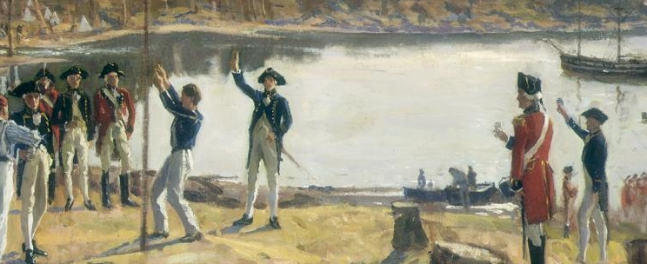
COLONISATION
It's important to recognise that from the beginning of colonisation, Indigenous people continually resisted the violation of their right to land, and its impact on indigenous cultures and communities. It's estimated that at least 20,000 aboriginal people were killed as a direct result of colonial violence during this era of Australian history. Between 2,000- 2,500 settler deaths resulted from frontier conflict during the same period.

Slide 16
Self-determination
“self-determination, the process by which a group of people, usually possessing a certain degree of national consciousness, form their own state and choose their own government. As a political principle, the idea of self-determination evolved at first as a by-product of the doctrine of nationalism, to which early expression was given by the French and American revolutions.”
Retrieved from: https://www.britannica.com/topic/self-determination
Discussion question: How might the British settlers have be threatened by self-determination in the people’s they ‘discovered’ as they travelled the world?

Slide 17
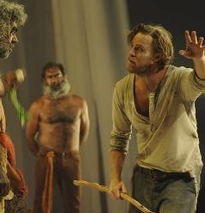
SECRET RIVER
Kate Grenville’s The Secret River (2005) focuses on the relationship between a family of settlers, the Thornhills, and the Darug people on the Hawkesbury river resonates with debates over Aboriginal self determination and government intervention in contemporary Australia.
The “problem” of Indigenous inhabitants, whose presence reminds invaders of the inauthenticity of their connection to the land they are attempting to claim as their own, is a central tension for national myths of origin. It is this problem that stands in the way of understanding oneself as possessing, and being authentically native to, the new nation, that Grenville’s text examines, and why there is a continual worrying-away at the question of difference.

Slide 18
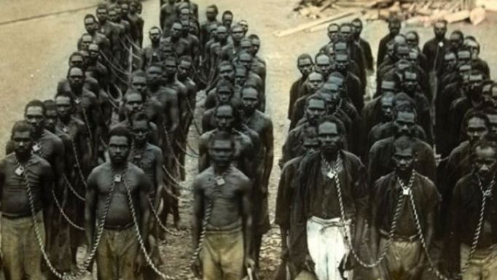
OTHERNESS
The text not only deconstructs national myths, but dismantles of otherness, and the deconstruction of binaries.
The novel “revisits and revises mythologized accounts of pioneering triumphs on the frontier, replacing them with conflict, violence, and loss.”
The text’s subversion of various tropes about Aboriginal people goes beyond providing a corrective to racist myths to reveal what lies at the heart of such stereotypes: it strikes at the heart of the oppositions that structure the way settler/Indigenous relations are represented, and disrupts the idea that one group is completely different from, and entirely unreachable by, the other.

Slide 19

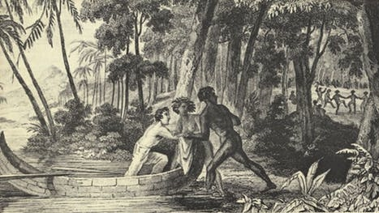
HISTORY’S CONSTRUCTION OF THE SAVAGE
The text blurs the distinction between savage and civilised, for example, through Will Thornhill’s gradually dawning awareness that far from being savages, the Darug have a social structure which is beyond his power to grasp. When Will and Sal order Dick not to play with the Darug children, the explanation Sal gives is “they’s savages, Dick. We’re civilised folk, we don’t go round naked” (222). Yet in the paragraphs that follow, we see how spurious this apparently “civilised” nature is when Will flies into a violent rage.
The process of undoing another pernicious antithesis—the association of Aboriginal people with the physical body and Europeans with the mind— begins right from the prologue, when the first Aboriginal man Will meets is able to imitate English words (5-6), while will has no success at producing Aboriginal words either initially or later. Sal’s statement, “why, you’re no better than a dumb animal” (207), which operates in conjunction with another binary, that of animal/human, is directed at the Darug, but is more applicable to the Thornhills themselves.

Slide 20
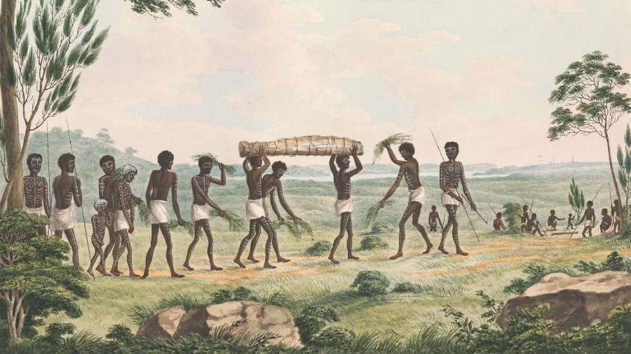
SECRET RIVER BREAKS COLONIAL STEREOTYPES
The Darug prove their shrewdness when they get the better of the Thornhills on several occasions, for example in the transaction over the kangaroo meat (235-236), and they are evidently cleverer in their use of cultivation and hunting techniques. These episodes also speak to another opposition: that of Europeans as naturally hard-working and effective.
Against the backdrop of the settlers’ grumbling that the Darug are lazy, Will comes to realise that in fact it is he who is not making the most effective use of his time in trying to provide food for his family, for example when he observes the way the Darug do not spend effort and energy fencing in kangaroos, but rather drive them to a particular place and then kill only as many as they need. When the Thornhills first notice the daisy yam plot, Will tells his sons that “them poxy blacks don’t plant nothing”, thinking that “like children, they did not plant today so that they could eat tomorrow. It was why they were called savages” (146). This is so clearly untrue that it is given to a child, Dick, to point out that the Darug do in fact cultivate crops, “[p]lanting them things like you would taters” (146). Later, when Dick, points to the superiority of the Darug’s farming methods—“no damned weeding the corn all day” (223)—this is so unwelcome that, for the first time in his life, Will gives his son a beating. The fury Will feels, it seems, arises not from Dick’s unwillingness to work but from the challenge to his way of thinking about the Darug as something other than civilised and Aboriginal people as naturally indolent.

Slide 21
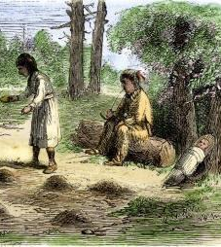
LIVING AND WORKING THE LAND
The narrative suggests a reason for the construction of the myth, aired repeatedly throughout the narrative, that Aboriginal people did not cultivate crops: it is not that they did not farm, but that the settlers did not recognise the farmed plots as agriculture. Moreover, when Will does unwillingly admit to himself that the patch of soil has been farmed, and that it is prime territory for the crops he wants to plant, he wants to take the plot for himself and thus uproots what the Darug have planted there. The obvious material benefits behind the assertion that “everyone knew the blacks did not plant things” (146) are made clear. The text not only foregrounds the power of discourse to establish differences in the face of clear evidence to the contrary, but puts forward reasons for why this might be such a powerful and lasting claim: if the Indigenous inhabitants of the land did not farm the land, they could not be using it, and it was much easier for the settlers to develop the terra nullius doctrine and to assert ownership.

Slide 22
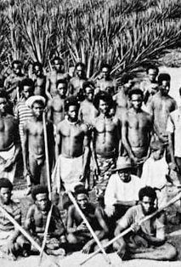
JUXTAPOSING IDEAS AND A NEW REALITY
Another means by which the text achieves this is by constant juxtaposing between the settlers and the Darug:
The two methods of farming, the two methods of making fire, the two patriarchs at the end of the novel.
Sal learns that the Darug women have their own routines of domestic work and childcare that resemble hers, while Dick—the child born in between England and Australia—plays with the Darug children, learns their language, and shows that it is possible to live in both worlds, until he is forbidden by his parents from associating with them any further.
These explorations of the innate differences dividing Europeans from Indigenous peoples, which have been used to legitimate the control of the latter by the former, may be Grenville’s fictionalisation of the actual agricultural and hunting practices along the Hawkesbury in the early nineteenth century. Nonetheless, they are effective in the decolonising ideas that colonists have used for hundreds of years.

Slide 23
On the first occasion where the Hawkesbury settlers gather at Thornhill’s point, Sagitty complains that the Darug have stolen his fowls, and Will remembers how he and Sal stole a hen back in England (169). Shortly afterwards, when Smasher rages that the Darug “ain’t nothing but thieves . . . don’t know how to do nothing but thieve off honest men!” (175), Blackwood points out that Smasher is himself a thief.
While the settlers repeatedly describe the Aboriginal people as animals or insects, the text keeps reiterating the animal-like characteristics of the settlers. Smasher likens the Aboriginal people to flies—“it’s like the bleeding flies . . . kill one, ten more come to its funeral” (169) yet is the first to appear like a bug “out of the woodwork” (167)
When alcohol is on offer. Webb says “they’s vermin . . . the same way rats is vermin” (170) yet is himself infested by nits and the first to have his crops eaten by corn-grubs, as well as having the nickname Spider (170).
Beyond the emphasis on vermin, there are other lines drawn between the settlers and animals: Sagitty has a “scalp ridged like a bulldog’s face” (168), Smasher a “scaly” (170) face, and Spider “hair rough as a dog’s” (168).
The accusations and metaphors used by the settlers keep being undermined by the settlers’ own behaviour: Spider’s claim that the Darug will “cut us up like you would a beast” and “[e]at the best bits” (170) recalls the description of his wife cooking chicken in a pot a few paragraphs earlier.

Slide 24
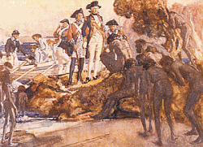
SUBVERTING IDEAS
These episodes in the novel serve to subvert established narratives about Europeans as naturally hard-working and Aboriginal people as naturally indolent and unable to cultivate crops.
In this way, the novel takes on familiar tropes about Indigenous peoples which have come to have a particular force within the Australian context and which continue to circulate in popular discourse today, not only around laziness and an inability to farm, but also around alcohol addiction.
The text initially fulfils expectations. One of the first Aboriginal men to appear in the narrative is an alcoholic and a figure of fun: when drunk he can be made to dance for the entertainment of the settlers and also for the good of Will and Sal’s business (94-95). However, along with Will, as we spend longer in the world of the text and encounter greater numbers of Aboriginal people, the picture becomes more complex: the obvious dependence of the settlers on alcohol implicitly undermines the association of Indigenous peoples with alcohol abuse.

Slide 25
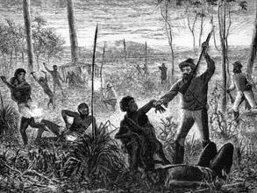
DECONSTRUCTING COLONIAL MYTHS
In its undermining of the dichotomies that underlie the settlers’ discourse—and its demonstration that the settlers exhibit the same characteristics for which they deride the Aboriginal population—Grenville’s novel can be seen in the line of what Canadian literary critics have theorised as historiographic metafiction. This is a subgenre of literary fiction in which texts employ the self-reflexive tactics of metafiction while being simultaneously grounded in social and historical reality, in order to engage with established narratives of national becoming and to deconstruct national myths.
Notes:
Metafiction: fiction in which the author self-consciously alludes to the artificiality or literariness of a work by parodying or departing from novelistic conventions and traditional narrative techniques.

